Slide 1

Construction in NL
Project 4 May 5, 2020
Sreelatha chunduri

Slide 2

https://opendata.cbs.nl/#/CBS/nl/.

Slide 3
Storyline
11 Data SETS
scope: only BUILDINGS & no infrastructure projects
1. COSTS - different types of buildings
2. Construction in Regions of nl
3. COUNT/NUMBER per type

Slide 4
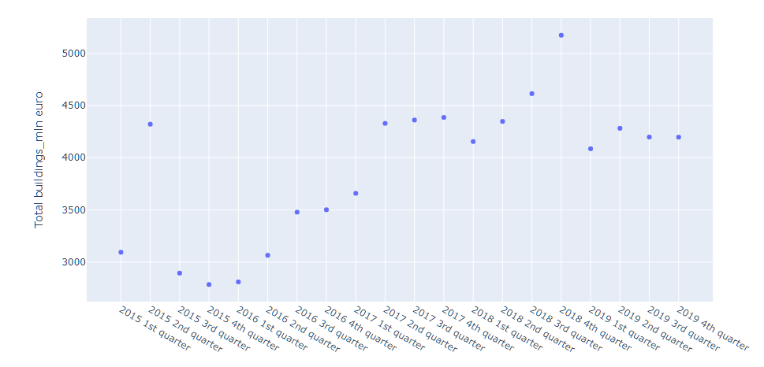
Total costs of all buildings in NL from 2015 - 2019
It includes buildings such as,
Dwellings
Offices
Combined company halls
Halls and warehouses
Agricultural sheds and stables
Shops
Schools
Other Buildings
In the past 5 years, 2018 had the highest peak in new buildings construction costs
About 5500 million euros were spent in NL on construction

Slide 5
From years 2015 through 2019
I would like to see the costs associated with the different types of buildings for the following 3 stages, where:
1. Construction started
2. Construction still in progress
3. Construction completed

Slide 6
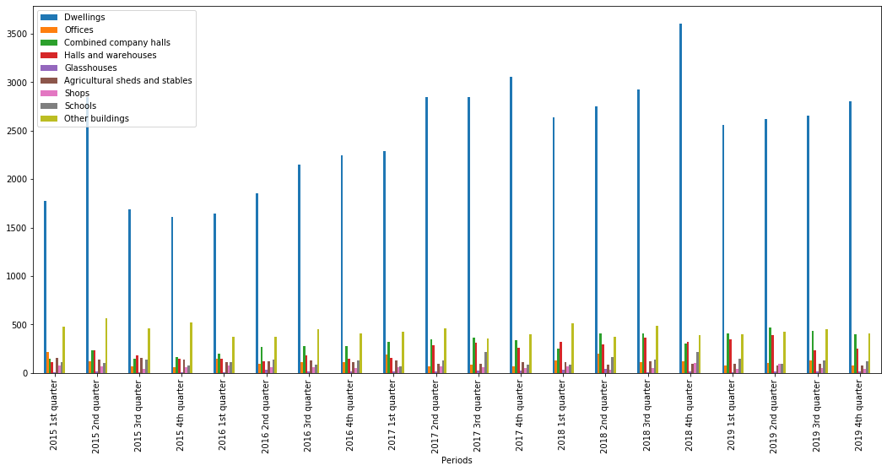
Construction Started 2015-2019

Slide 7
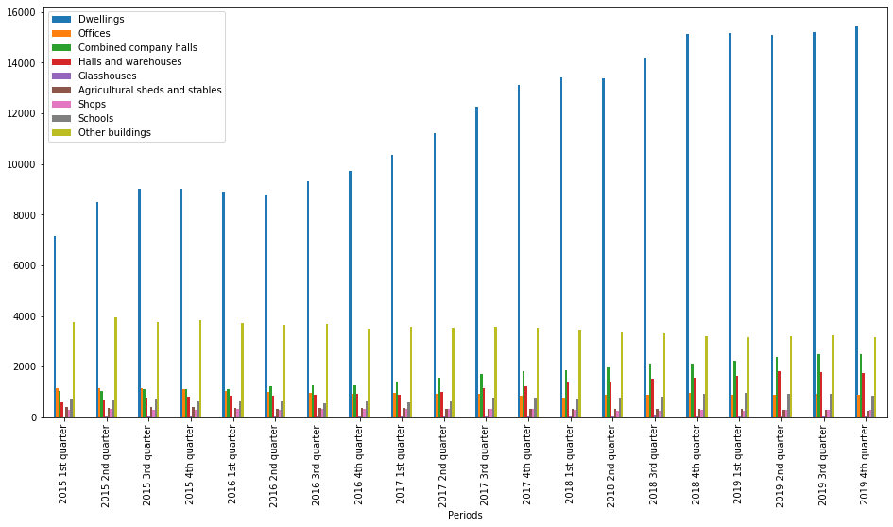
Under Construction 2015-2019

Slide 8
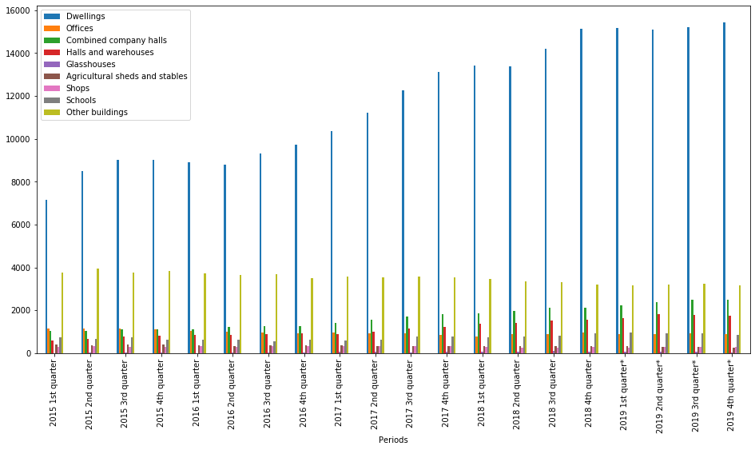
Completed Buildings 2015-2019

Slide 9


First Conclusion
Dwellings are always the buildings that are in some phase of construction compared to all the other building categories and they belong to the highest cost spent.
Dwellings
Other buildings
Combined company halls
Halls and warehouses
It is interesting to see that they are consistent no matter what stage of construction (started, completed and in-progress) they are in.

Slide 10
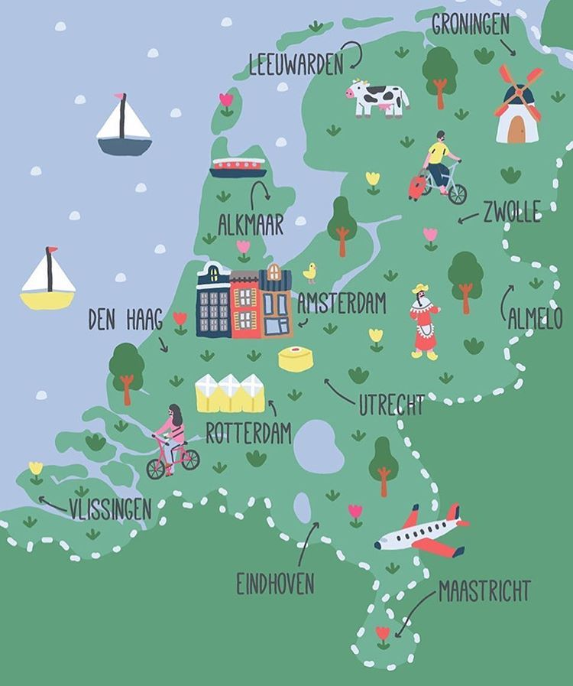
Regions of NL
Noord
Oost
West
Zuid
NOTE: Data available only from 2015-2017

Slide 11
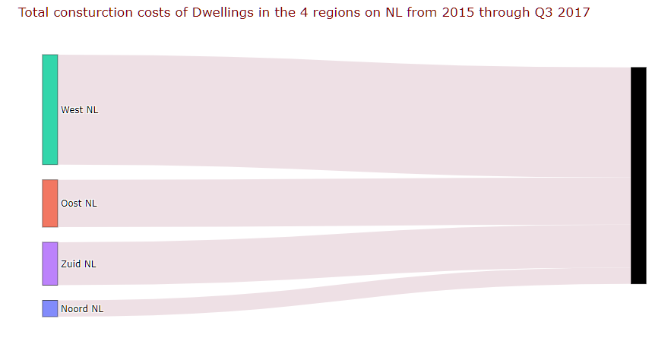
Region that spent the highest on Housing

Slide 12
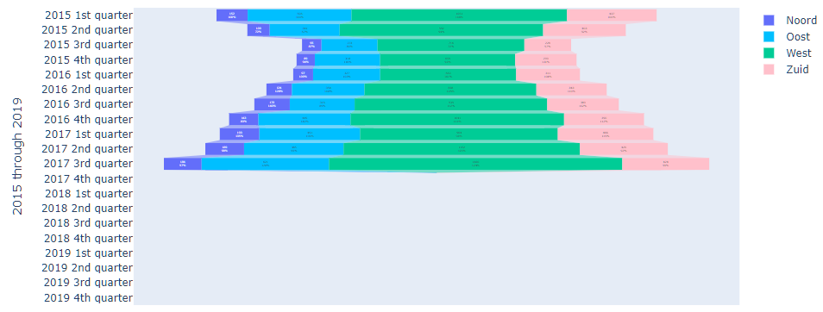
2015 - 2019

Slide 13
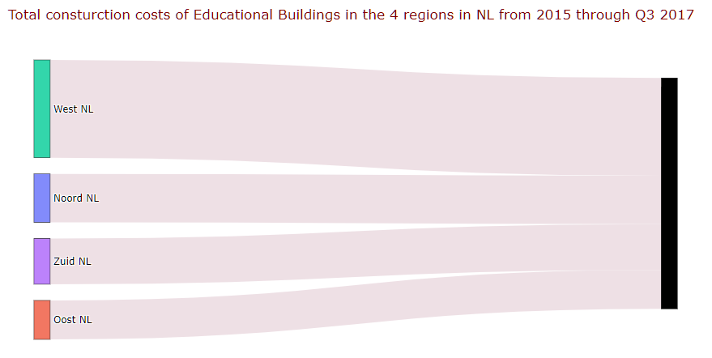
Region that spent the highest on Educational Buildings

Slide 14
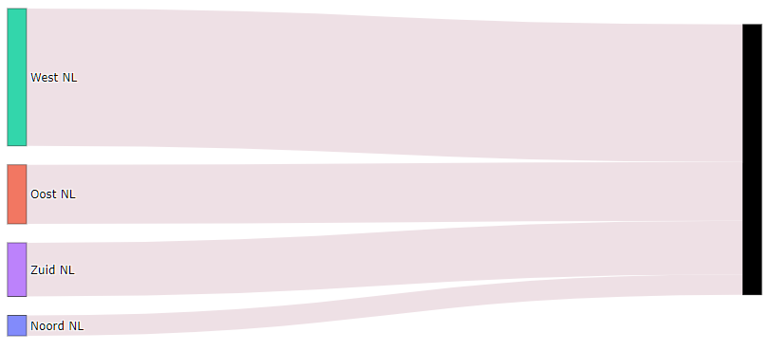
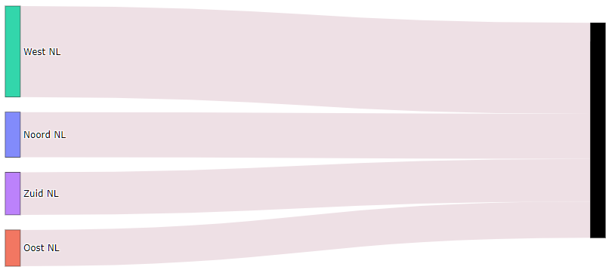
Comparison
Housing
Education

Slide 15
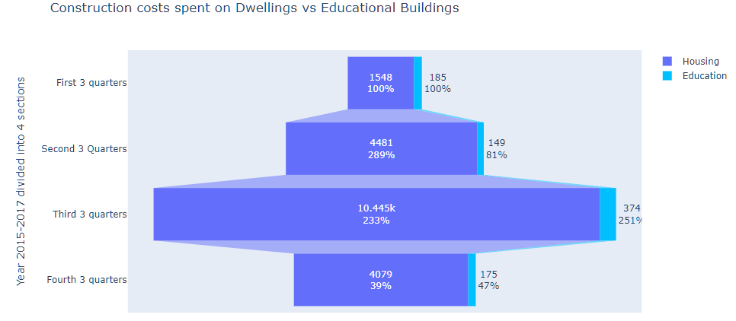
Funnel Chart Visualization

Slide 16
Second Conclusion
NOORD
WEST
Housing:
West
Oost
Zuid
Noord
Educational Buildings:
West
Noord
Zuid
Oost
OOST
ZUID
A significantly higher amount of money is spent on Housing than on Educational buildings.

Slide 17
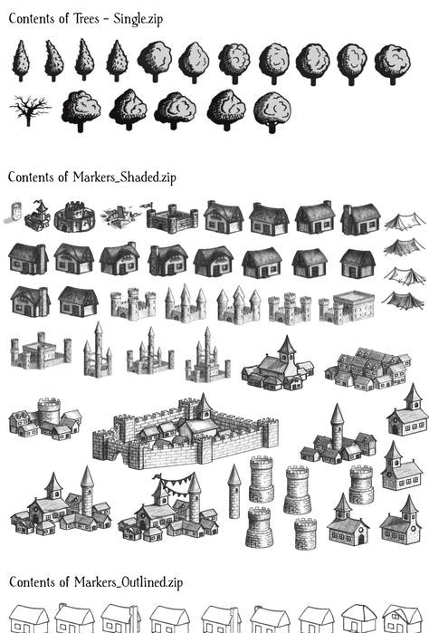
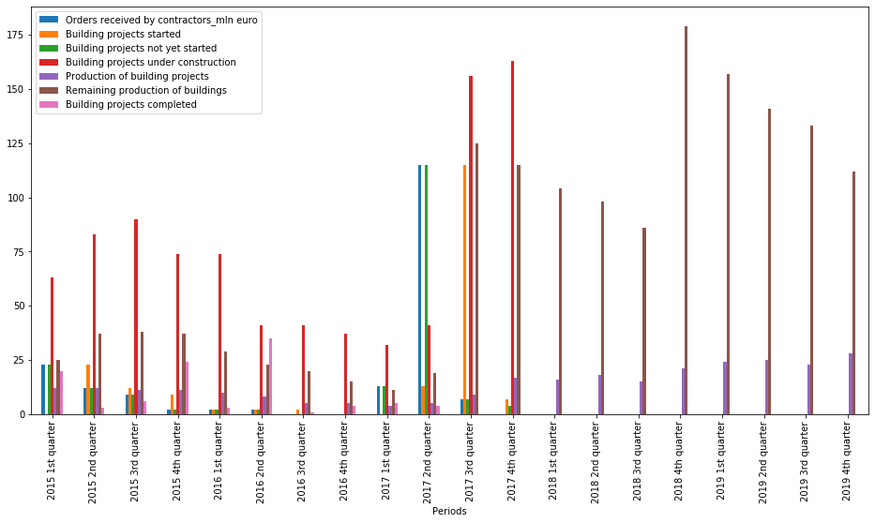
Count
NUMBER OF HOUSING AND EDUCATIONAL BUILDINGS BUILT IN NOORD AND ZUID NEDERLAND BASED ON CONSTRUCTION STAGE

Slide 18
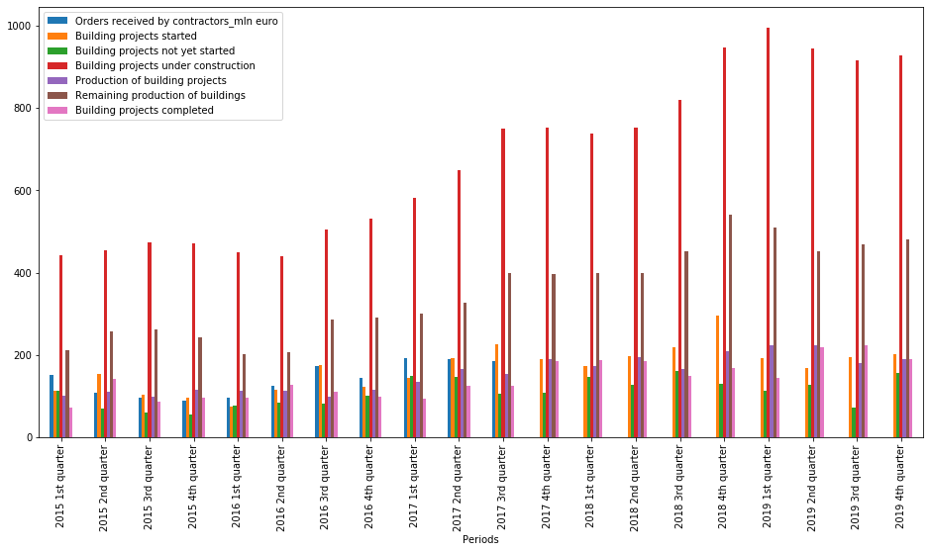
Number of Noord Nederland "Dwellings" based on construction stage

Slide 19
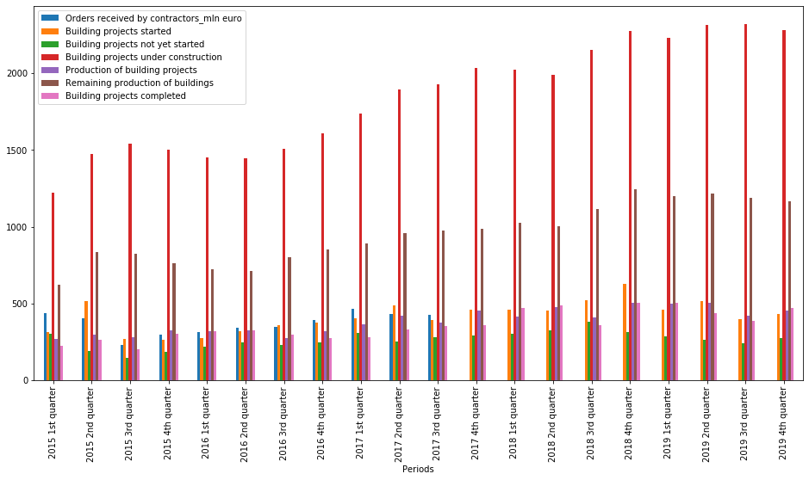
Number of Zuid Nederland "Dwellings" based on construction stage

Slide 20
Number of Noord Nederland “Educational“ buildings based on construction stage

Slide 21
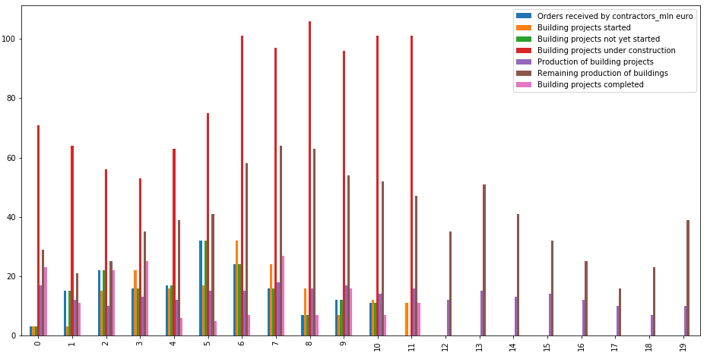
Number of Zuid Nederland “Educational“ buildings based on construction stage

Slide 22
Third Conclusion
We see that on an average that we have between 400 and 800 “Dwelling” under construction in each quarter of the year in the Noord and Zuid Nederland.
There are no “Educational” buildings under construction in each quarter of the year in the Noord and Zuid Nederland.

Slide 23

Research Questions
Q1: What is the mean of the "Orders received by contractors in million euros" between years 2015 and 2019 for Noord Nederland?
Q2: Is the mean value of the Orders received by contractors for "Education" buildings less than the Orders received by contractors for “Housing" in Noord Nederland from years 2015-2017?
Q3: Are the “Housing" orders received by contractors and the number of “Housing" projects where the construction started correlated?

Slide 24

What is the mean of the "Orders received by contractors in million euros" between years 2015 and 2019 for Noord Nederland?
We only have data from years 2015 through 2017. So we can use this data as sample data and estimate the mean of the population.
Confidence Interval:
The standard deviation of the population is not known. So, I will use the standard deviation of the sample.
With 95% confidence, the true mean lies in the interval: [41.131100480556746, 113.66889951944327]
Therefore, the mean cost of the "Orders received by contractors in million euro" between years 2015 and 2019 for Noord Nederland is between 41 and 113 million euros.

Slide 25
Is the mean value of the Orders received by contractors for Educational buildings less than the Orders received by contractors for Housing in Noord Nederland from years 2015-2017?
I would like to do a 1 tailed t-test to test
The mean of the orders received by contractors for housing = 77.4 million euros
Ho: the average cost of all orders received for education buildings is >= 77.4 million euros
Ha: the average cost of all orders received for education buildings is < 77.4 million euros
Statistic: 18.581707128294866
p-value: 1.2074730576215766e-13
Null hypothesis rejected
This means that the mean value of the Orders received by contractors for "Education" buildings is less than the Orders received by contractors for "Dwellings" in Noord Nederland from years 2015-2017

Slide 26

Are the “Housing" orders received by contractors and the number of “Housing" projects where the construction started correlated?
I would like to assume that the "Dwelling" orders received by contractors and the number of "Dwelling" where the construction started are correlated. I would like to check if there is linear or a nonlinear regression between the variables.
There is a negative correlation between the two chosen variables.
Negative correlation is a relationship between two variables in which one variable increases as the other decreases, and vice versa.

Slide 27
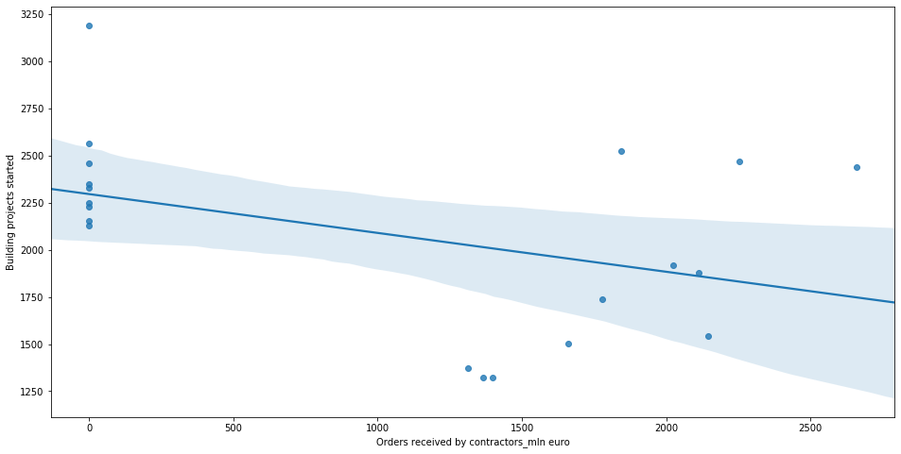
Building a regression model for the data from two variables "Orders received by contractors in million euros" and "Building projects started"

Slide 28
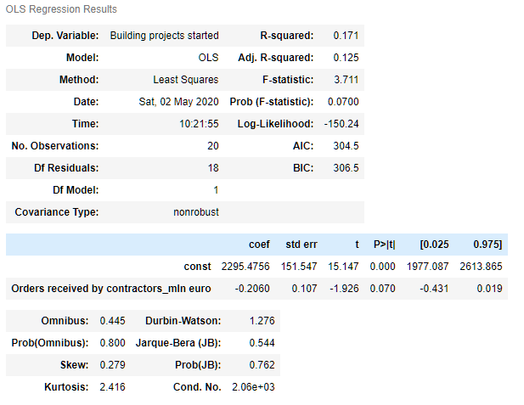
Therefore there is no correlation between Housing orders received by contractors, and the number of Housing projects where the construction started
1. The p-value is more than 0.05. It is 0.07 and we can say that the variables are not statistically significant.
2. The F-statistics is also high. It is 3.711 and we can say that the overall model is not significant.
3. The R-squared value is a widely-used measure that describes how powerful a regression is.
The R-squared measures how much of the total variability is explained by our model.
Here the R-squared value is 0.171. R-squared of 1 would mean our model explains the entire variability of the data.
What we usually observe are values ranging from 0.2 to 0.9. The value we got here doesn't fall under that category and we can conclude that the regression is not strong.

Slide 29
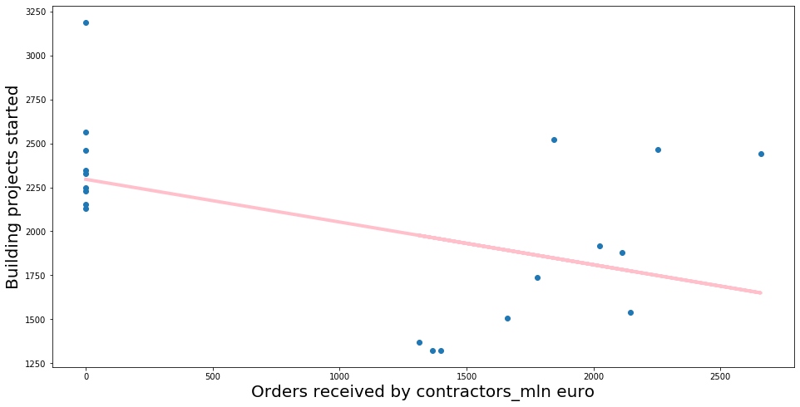
Plotting the regression model on the scatter plot

